Slide 1
Did The Lord Build More Than One Church?
Is one church just as good as another?

Slide 2
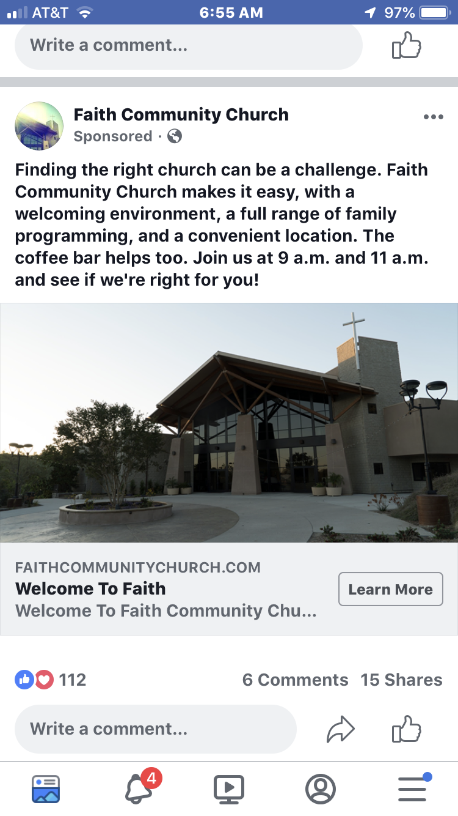

Slide 3
More than one church?
Not a personal defense. 1 Pet. 3:15
Not purpose to defend where I worship.
Not purpose to identify. Qualities and Characteristics.
Provoke study.
Some arguments are inconsistent.
Some illogical.
Contradict the bible.

Slide 4
If the Lord built more than one church,
Then…The text of Matthew 16:13-20 is grammatically incorrect.
“And I also say unto thee, that thou art Peter, and upon this rock I will build my church; and the gates of Hades shall not prevail against it.” (Mt. 16:18)

Slide 5
If the Lord built more than one church,
Then…He approves of all of them.
Yet, there are some things the Father did not plant. Mt. 15:7-13; Heb. 8:2

Slide 6
If the Lord built more than one church,
Then…God is self-contradictory.
Yet, God is not the author of confusion. 1 Cor. 14:33

Slide 7
If the Lord built more than one church,
Then… God would contradict His law of production and reproduction.
Yet, seed produces “after its kind.” Gen. 1:24-25
Lk. 8:11 The word is the seed of the kingdom.
Gal. 6:7 We reap what we sow.

Slide 8
If the Lord built more than one church,
Then… He is the head of all denominations.
Catholic
Protestant
Christ
Pope
Christ
One
Church

Slide 9
If the Lord built more than one church,
Then… He is the head of all denominations.
Yet…
Christ
(Head)
Eph 1:22-23 “and gave him to be head over all things to the church, which is his body”
Eph 5:23 “For the husband is the head of the wife, and Christ also is the head of the church, (being) himself the saviour of the body.”
One
Church
(One Body)

Slide 10
If the Lord built more than one church,
Then… The blood of Christ is of no benefit to the salvation of the world.
Yet… Christ purchased the church with His blood. Acts 20:28; cf. Eph. 5:23-25

Slide 11
If the Lord built more than one church,
Then… He built something that He prayed against.
Yet… Jesus prayed for unity among believers. Jno. 17:20ff; cf. 1 Cor. 1:10

Slide 12
If the Lord built more than one church,
Then… No one could be a member of any one of them on the basis of conviction…. i.e. “I belong to this one because it is right.”
Yet… Conviction is commanded. 1 Pet. 3:15

Slide 13
If the Lord built more than one church,
Then…Christ would have the same spiritual relationship to all of them. (He would be a spiritual polygamist.)
Yet… The church is the bride of Christ. Eph. 5:23ff; Rom. 7:1ff; 2 Cor. 11:2; Cf. Isa. 54:5

Slide 14
If the Lord built more than one church,
Then… It doesn’t make any difference what we preach, believe or practice.
Yet… Teaching the tradition of men made worship vain. Mt. 15:7-9
Yet… Paul pronounced the curse of God upon anyone who would preach anything different. Gal. 1:6-9

Slide 15
If the Lord built more than one church,
Then… The Lord made a mistake in addition… He added when He should have divided.
Yet… The Lord ADDED the saved to the CHURCH.
Acts 2:47 “And the Lord added to the church daily such as should be saved.”

